Slide 1
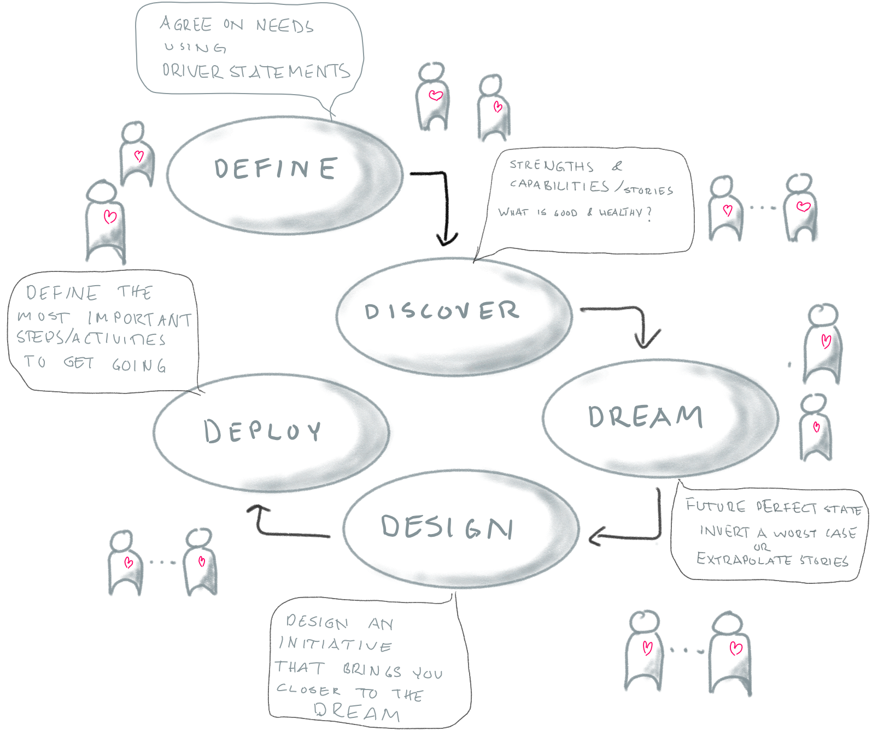
Appreciative Inquiry – the 5D process of co-creation
The below section holds the working material and outputs for
ID:

Slide 2
DEFINE - Instructions
Marshall Rosenberg developed an advanced way to achieve psychological safety and clarity in groups and other relationships that became known as “non-violent communication”. In a way it is a practical way to use what Bertrand Russel called “critical thought” in daily conversation. The basic premise is that all statements are subjective, but that all people share the same needs. By linking needs to the subjective assessments that leads to their identification, it is much easier to verify that two people are really talking about the same thing. This is key for achieving intersubjectivity when it comes to later stages in any process.
1. Individually – write two or three whishes that would make significant difference to you.
2. Self organize groups around wishes (using e.g. open space).
3. In each group : Create a driver statement in three parts (as below). Staring from the wish – what do you see in the organization (observations and effects) that makes you wish what you do?
Observation
Effect (of observation)
Need/Wish

Slide 3
ID:
Driver Statement
Observation:
Effect (of observation):
Need (whish):

Slide 4
DISCOVER - Instructions
In 1987, leadership scholar David Cooperrider proposed a new method for changing organisations. He called it “Appreciative Inquiry” and it quickly got the attention of the research community, being cited in more than 2,500 research papers since then.
Appreciative Inquiry is a strength-based, collaborative approach that enables change and growth beyond the usual “problem-solving-approach”. By recognizing the best of ‘what is’ and building upon these strengths, we can identify opportunities for improvement, build motivation and momentum, access our creativity and co-create a desired future.
This step of the 5D-process is to focus on what is good in the present. What is working well? What is creating success? What strengths do we possess? What successful experiences do we have?
1. Share moments & stories where YOU have had peak experiences connected to a wish.
2. Either first share in pairs, or in full group.
NOTE: ONLY share peak experiences – when this worked really well. NO solutions. NO needs. NO problems in this step!

Slide 5
ID:
Strengths
If you want : capture highlights, strengths and experiences from the shared stories. Create a view of what is possible.

Slide 6
DREAM - Instructions
Dreaming is important. When we have a clear dream, we consciously, and unconsciously, alter our behavior, thoughts and actions to attract events to reach our dream.
Generally, people are much better at identifying potential disasters than future opportunities. Cognitive scientists call this “risk bias”. In this section we will use this quirk of the human brain to identify elements of an ideal future. This will allow us to very quickly describe a future perfect state.
1. Describe what a terrible future would look like related to the wish you work with (driver statement, Blue slide). What is the absolute worst case scenario that you can imagine? (And remember to have fun in the process. Play a bit!). Spend just a few minutes on this.
2. Flip that statement to its opposite. Discuss what the future perfect state looks like. Write this on the next page.
3. Imagine that you have reached the future perfect state: - What is made possible? - What does that enable for YOU in your daily life? - How would that make you feel?

Slide 7
ID:
Dream / Perfect Future State
Dream:
text
What is made possible when you reach the dream?
What does that enable for YOU in your daily life?
How would that make you feel?
text

Slide 8
DESIGN - Instructions
Now, we want to connect with what stands in our way. What hinders us? What we need to let go of? And what we need to let come? This is best done by accessing our sub-conscious. Where we hold information that we don’t know of. Do this by a guided meditation.
Guiding: --- Relax. Breathe. get in connection with your body. Be with your dream. Sense it. Envision it. Become aware of your current Self, Other, System. What assumptions are holding you back? What chosen truths do you hold in your system? What limiting beliefs? What limiting structure do you hold? What do you need to let go of? What do you need to let come?
Observe your current culture and structure: What prevent you from meeting & connecting? What prevent you from learning? What do you need to let go of? What do you need to let come? ---
Individually – quickly jot down what came up for you.
Share. What came up for you as a group. Collect you gathered findings on the next page.
You have now co-created a sense of importance and are ready for the next step. To create learning experiments and actions that lead you toward the DREAM, using your strengths, adding what is missing.

Slide 9
ID:
Design
Existing limiting assumptions, chosen truths and beliefs:
What prevent you from meeting & connecting and learning?
Limiting team/org. structure:
Limiting team/org. culture:
What do we need to let go of?
What do we need to let come?

Slide 10
DEPLOY - Instructions
In this last part we will focus on what often is the starting point of many processes “what should we actually be doing?”. By grounding this in the previous steps we will have anchored the output in the collective intelligence and the dreams and motivations of the group.
“The only real voyage of discovery consists not in seeking new landscapes but in having new eyes.” -Proust
1. Shape initiative suggestions that form a first step towards the dream. Letting go what you need to let go of. Letting come what you need to let come. (from the Design step).
One per slide below.
For each activity, also ask yourselves: What current resources and strengths do we have to help us?
Do as many as you need, but remember: quality before quantity..

Slide 11
ID:
Initiative
Headline:
Detailed Description (What do you want to create, & learn?)
How would you sense that you are in the right path (How to measure?):
Key Stakeholders (to be involved/informed):
Resources and strenghts available:
Support/Help needed:
PRIO: (High, Med, Low): Driver/Owner:

Slide 12
REFLECTION
“The only real voyage of discovery consists not in seeking new landscapes but in having new eyes.” -Proust
Start by reflecting on the ways that this workshop has changed your mind about the topics discussed. Think for a couple of minutes and then do a round of sharing.
We have arrived!

